Slide 1
Tree Mahdi Ebrahimi

Slide 2
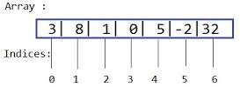
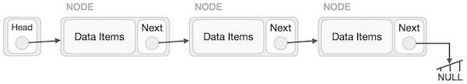
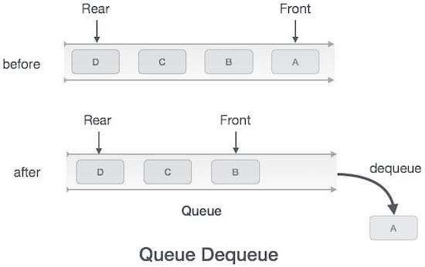

Linear data structures
stack

Slide 3
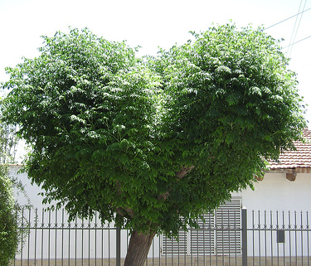


Introduction to trees
In COMP 182/L, you have learned mainly linear data structures – arrays, lists, stacks and queues
In this course, we will discuss a non-linear data structure called tree.
Trees are mainly used to represent data containing a hierarchical relationship between elements, for example, records, family trees and table of contents.
Consider a parent-child relationship
https://en.wikipedia.org/wiki/Tree_(data_structure)

Slide 4
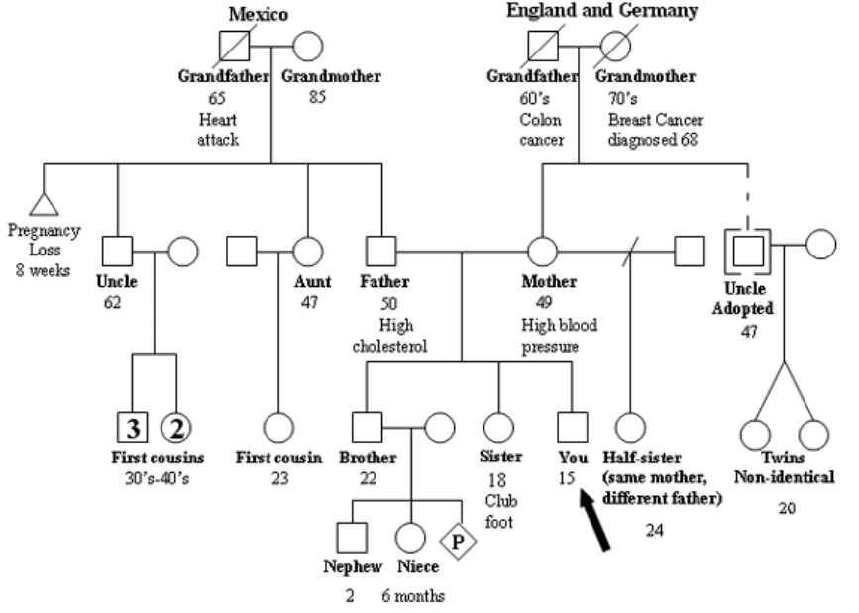
Example
Pedigree from the National Society of Genetic Counselors website: www.nsgc.org

Slide 5
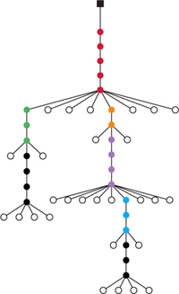
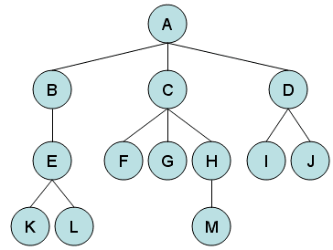
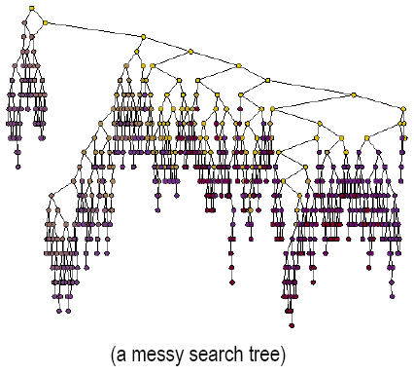

Slide 6
Terminology
Names are from Botany and Genealogy: node, branch, depth (height), root, leaf, non-leaf (inner node), path, forest; parent, child, sibling, cousin, ancestor, descendant, and subtree.
More terms...

Slide 7
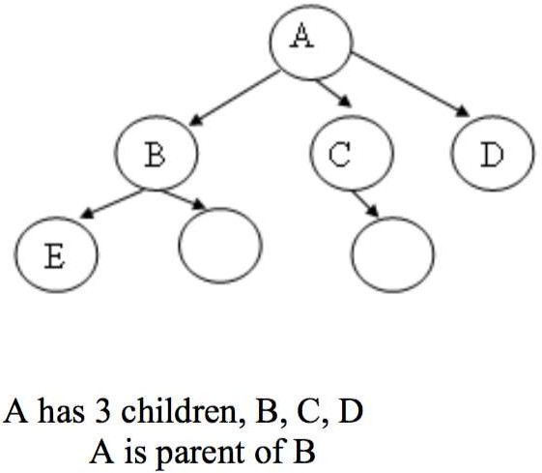
Tree
A tree is an abstract model of a hierarchical structure that consists of nodes with a parent-child relationship.
Tree is a sequence of nodes
There is a starting node known as a root node
Every node other than the root has a parent node.
Nodes may have any number of children
Notes:
A tree is a collection of nodes with one root and branches that are trees.
A tree is a finite set of nodes such that:
there exists a specially designated node called root;
the remaining nodes are partitioned into n ≥ 0 disjoint sets, T1, T2, ..., Tn, where each of these sets is a tree, known as subtree.

Slide 8
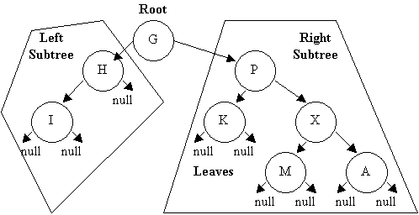
Tree
A tree is a collection of nodes with one root and branches that are trees.
A tree is a finite set of nodes such that:
there exists a specially designated node called root;
the remaining nodes are partitioned into n ≥ 0 disjoint sets, T1, T2, ..., Tn, where each of these sets is a tree, known as subtree.
Notes:
A tree is a collection of nodes with one root and branches that are trees.
A tree is a finite set of nodes such that:
there exists a specially designated node called root;
the remaining nodes are partitioned into n ≥ 0 disjoint sets, T1, T2, ..., Tn, where each of these sets is a tree, known as subtree.

Slide 9
Characteristics of trees
Non-linear data structure
Combines advantages of an ordered array
Searching as fast as in ordered array
Insertion and deletion as fast as in linked list
Simple and fast

Slide 10
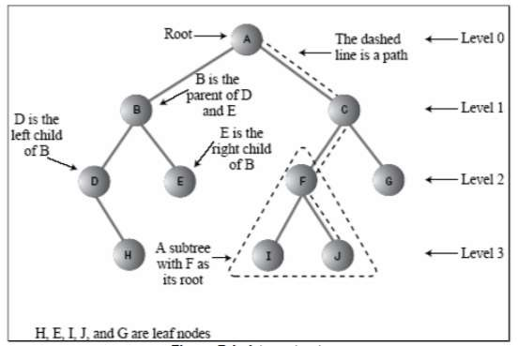

Slide 11
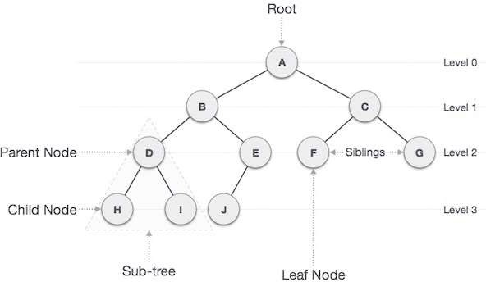

Slide 12
Some Key Terms:
Root − Node at the top of the tree is called root.
Parent − Any node except root node has one edge upward to a node called parent.
Child − Node below a given node connected by its edge downward is called its child node.
Sibling – Child of same node are called siblings
Leaf − Node which does not have any child node is called leaf node.
Sub tree − Sub tree represents descendants of a node.
Levels − Level of a node represents the generation of a node. If root node is at level 0, then its next child node is at level 1, its grandchild is at level 2 and so on.
keys − Key represents a value of a node based on which a search operation is to be carried out for a node.

Slide 13
Some Key Terms:
Degree of a node:
The degree of a node is the number of children of that node
Degree of a Tree:
The degree of a tree is the maximum degree of nodes in a given tree
Path:
It is the sequence of consecutive edges from source node to destination node.
Height of a node:
The height of a node is the max path length form that node to a leaf node.
Height of a tree:
The height of a tree is the height of the root
Depth of a tree:
Depth of a tree is the max level of any leaf in the tree

Slide 14
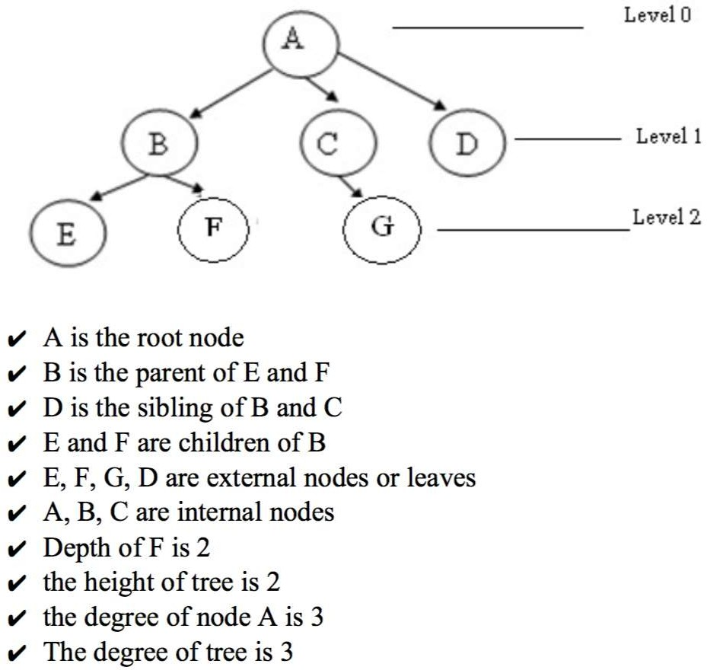

Slide 15
Classification
By maximum number of branches -- binary, ternary, n-way
By heights of substree -- balanced, unbalanced trees
By changeability -- static, dynamic trees

Slide 16
Classification
Empty (Null)-tree: a tree without any node
Root-tree: a tree with only one node
Binary tree: a tree in which each node has at most two children (parent, left, and right)
Two tree: a binary tree that either is empty or each non-leaf has two children
Heap: a tree where parent node has bigger (smaller) value than children
And many others: binary search tree (BST), 2-3 tree, AVL tree, B-tree/B⁺-tree, Huffman tree, Red-Black tree, Game tree, Spanning tree, etc.

Slide 17
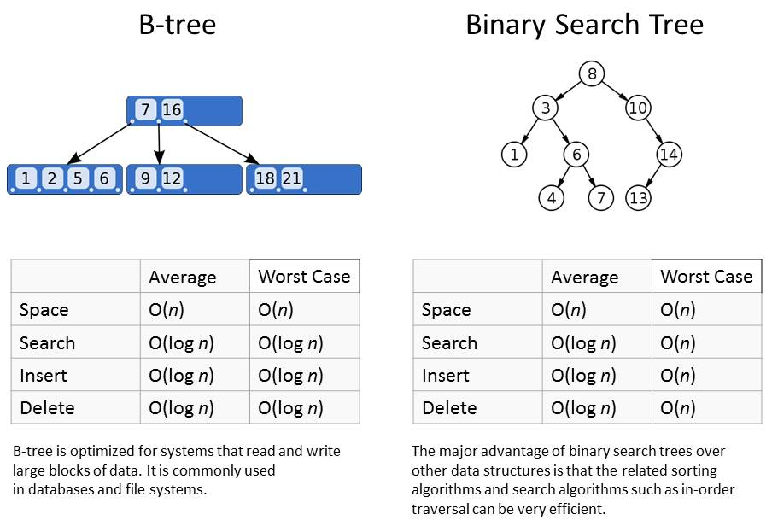
Why Tree Structure?
O(log n)
Notes:
Some languages do provide support for Binary Search Trees. In Java, see the TreeMap class, which implements a variant of the Binary Search Tree, the Red-Black Tree.

Slide 18
Applications
Directory structure of a file store
Structure of an arithmetic expressions
Used in almost every 3D video game to determine what objects need to be rendered.
Used in almost every high-bandwidth router for storing router-tables.
used in compression algorithms, such as those used by the .jpeg and .mp3 file- formats.
FOR Further detail Click Here

Slide 19
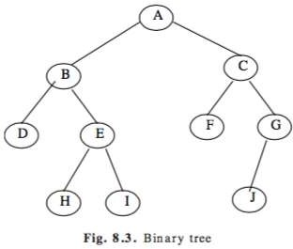
Introduction To Binary Trees
A binary tree, is a tree in which no node can have more than two children.
Consider a binary tree T, here ‘A’ is the root node of the binary tree T.
‘B’ is the left child of ‘A’ and ‘C’ is the right child of ‘A’
i.e A is a father of B and C.
The node B and C are called siblings.
Nodes D, H, I, F, J are leaf node

Slide 20
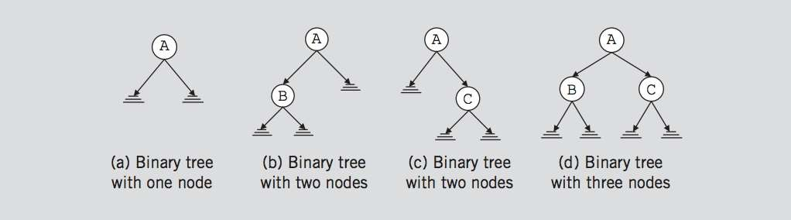
Binary Trees
A binary tree, T, is either empty or such that
T has a special node called the root node
T has two sets of nodes L_{T} and R_{T}, called the left subtree and right subtree of
T, respectively.
L_{T} and R_{T} are binary trees.
III.

Slide 21
Binary Tree
A binary tree is a finite set of elements that are either empty or is partitioned into three disjoint subsets.
The first subset contains a single element called the root of the tree.
The other two subsets are themselves binary trees called the left and right sub-trees of the original tree.
A left or right sub-tree can be empty.
Each element of a binary tree is called a node of the tree.

Slide 22
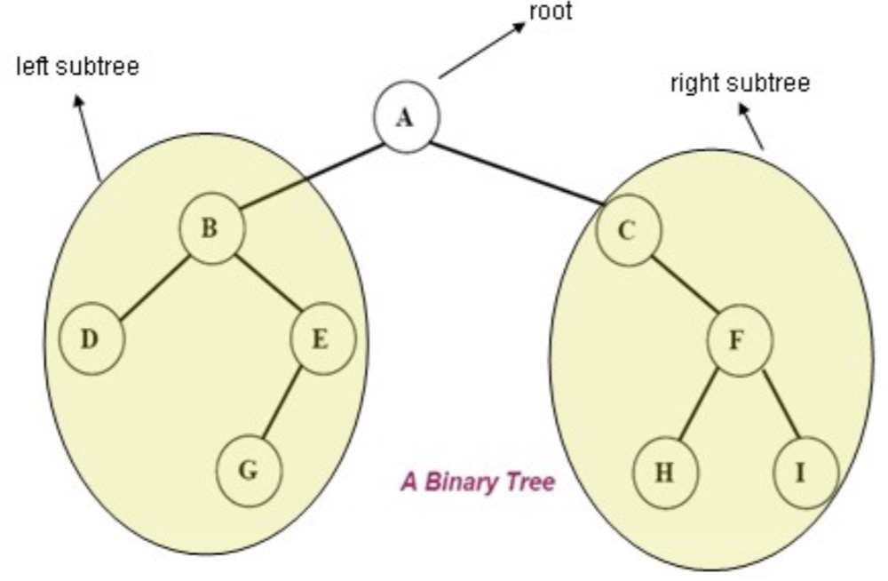
The following figure shows a binary tree with 9 nodes where A is the root

Slide 23

Binary Tree
The root node of this binary tree is A.
The left sub tree of the root node, which we denoted by L_{A}, is the set L_{A} = {B,D,E,G} and the right sub tree of the root node, R_{A} is the set R_{A}={C,F,H}
The root node of L_{A} is node B, the root node of R_{A} is C and so on

Slide 24
Binary Tree Properties
If a binary tree contains m nodes at level L, it contains at most 2m nodes at level L+1
Since a binary tree can contain at most 1 node at level 0 (the root), it contains at most 2L nodes at level L.

Slide 25
Types of Binary Tree
Strictly binary tree
Almost complete (full) binary tree
Perfect Binary Tree

Slide 26
Full BT VS Complete BT
A full binary tree of depth k is a binary tree of depth k having 2^{k} -1 nodes, k >= 0.
A binary tree with n nodes and depth k is complete iff its nodes correspond to the nodes numbered from 1 to n in the full binary tree of depth k.
A
A
B
C
B
C
D
E
F
G
D
E
F
G
H
I
J
K
L
M
N
O
H
I
Complete binary tree
Full binary tree of depth 4

Slide 27
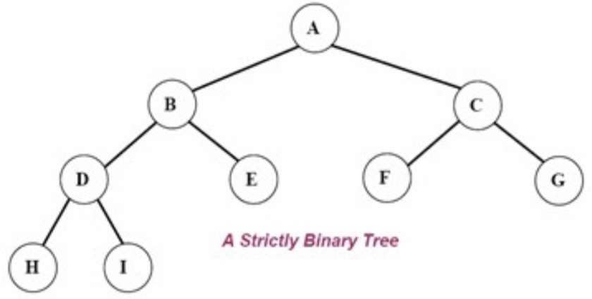
Strictly binary tree
If every non-leaf node in a binary tree has nonempty left and right sub-trees, then such a tree is called a strictly binary tree.
Or, to put it another way, all of the nodes in a strictly binary tree are of degree zero or two, never degree one.
A strictly binary tree with
N leaves always contains 2N – 1 nodes.

Slide 28
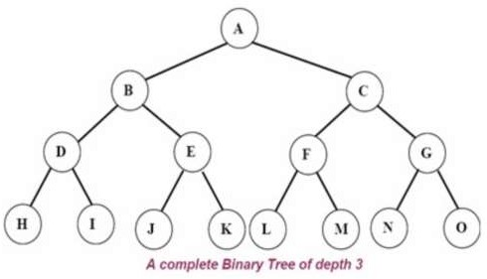
Complete binary tree
A complete binary tree is a binary tree in which every level, except possibly the last, is completely
filled, and all nodes are as far left as possible.
A complete binary tree of depth d is called strictly binary tree if all of whose leaves are at level d.
A complete binary tree has 2^{d} nodes at every depth d and 2^{d} -1 non leaf nodes

Slide 29
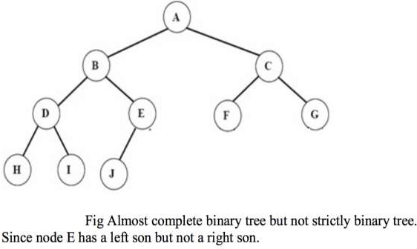
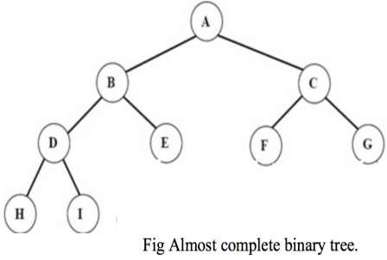
Almost complete binary tree
An almost complete binary tree is a tree where for a right child, there is always a left child, but for a left child there may not be a right child.

Slide 30
Binary Tree Representations
If a complete binary tree with n nodes (depth = log n + 1) is represented sequentially, then for any node with index i, 1<= i <=n, we have:
parent(i) is at i/2 if I !=1. If i=1, i is at the root and has no parent.
left_child(i) ia at 2i if 2i<=n. If 2i>n, then i has no left child.
right_child(i) ia at 2i+1 if 2i +1 <=n. If 2i +1 >n, then i has no right child.

Slide 31
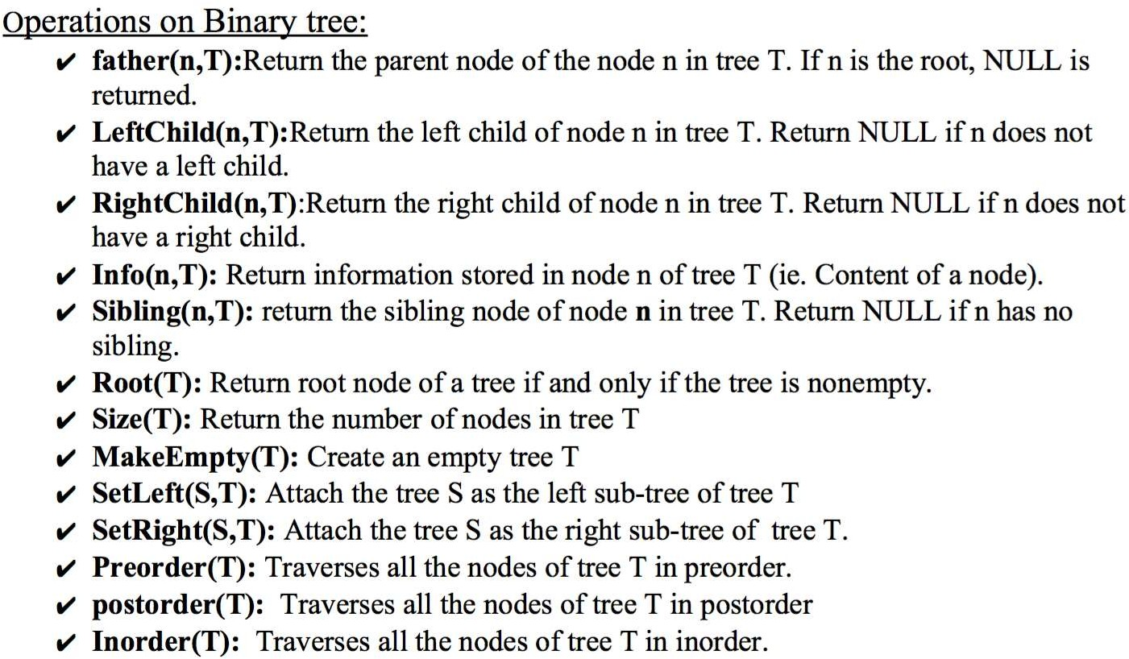

Slide 32
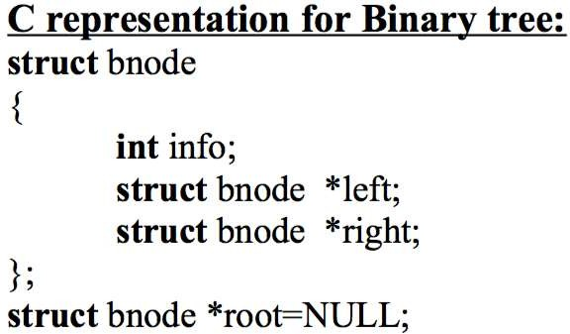
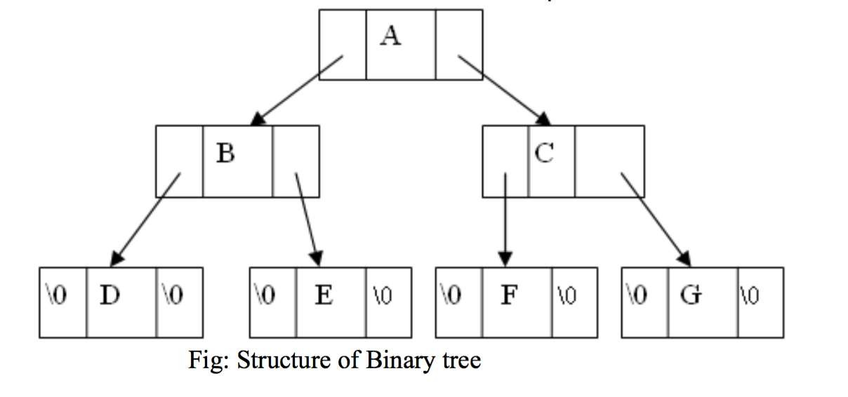

Slide 33
Tree traversal
Traversal is a process to visit all the nodes of a tree and may print their values too.
All nodes are connected via edges (links) we always start from the root (head) node.
There are three ways which we use to traverse a tree
In-order Traversal
Pre-order Traversal
Post-order Traversal
Generally we traverse a tree to search or locate given item or key in the tree or to print all the values it contains.

Slide 34
Pre-order, In-order, Post-order
Pre-order
<root><left><right>
In-order
<left><root><right>
Post-order
<left><right><root>

Slide 35
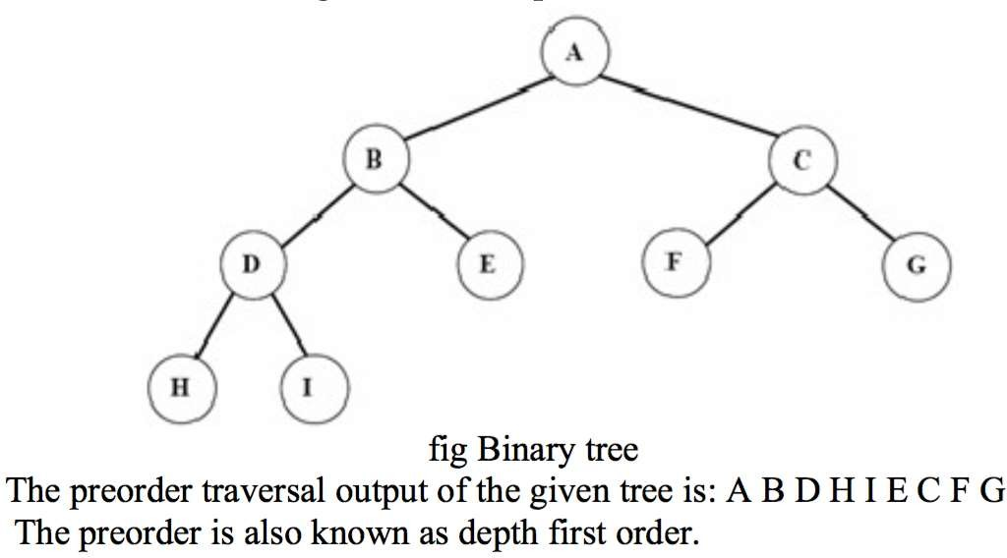
Pre-order Traversal
The preorder traversal of a nonempty binary tree is defined as follows:
Visit the root node
Traverse the left sub-tree in preorder
Traverse the right sub-tree in preorder
Ashim Lamichhane
27

Slide 36
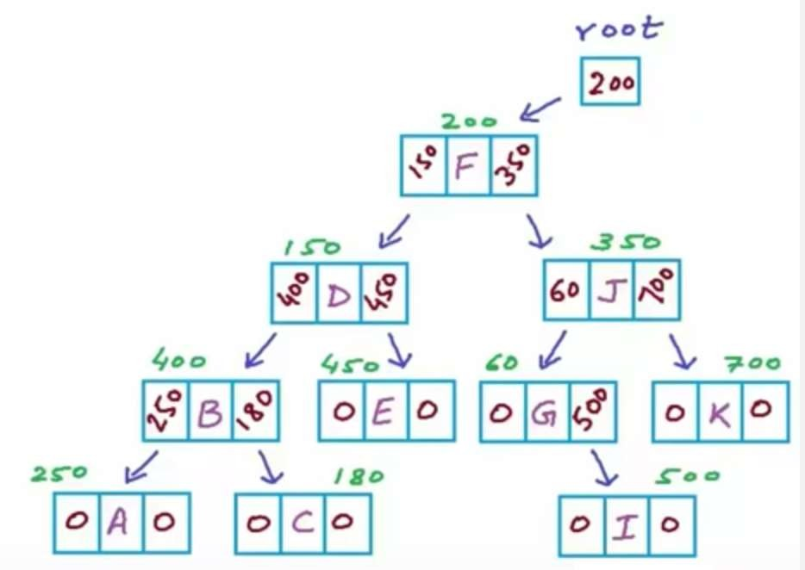
Pre-order Pseudocode
struct Node{ char data; Node *left; Node *right;
}
void Preorder(Node *root)
{
if (root==NULL) return; printf (“%c”, root->data);
Preorder(root->left); Preorder(root->right);
}

Slide 37
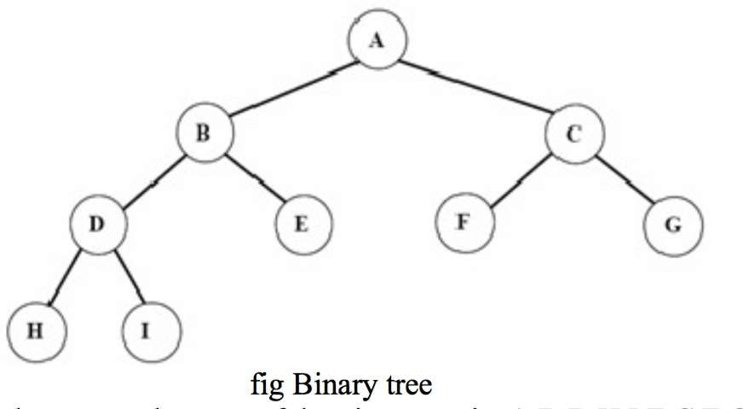
In-order traversal
The in-order traversal of a nonempty binary tree is defined as follows:
Traverse the left sub-tree in in-order
Visit the root node
Traverse the right sub-tree in inorder
The in-order traversal output of the given tree is
H D I B E A F C G

Slide 38
In-order Pseudocode
struct Node{ char data; Node *left; Node *right;
}
void Inorder(Node *root)
{
if (root==NULL) return; Inorder(root->left);
printf (“%c”, root->data); Inorder(root->right);
}

Slide 39
Post-order traversal
The in-order traversal of a nonempty binary tree is defined as follows:
Traverse the left sub-tree in post-order
Traverse the right sub-tree in post-order
Visit the root node
The in-order traversal outp of the given tree is
H I D E B F G C A
ut

Slide 40
Post-order Pseudocode
struct Node{ char data; Node *left; Node *right;
}
void Postorder(Node *root)
{
if (root==NULL) return; Postorder(root->left);
Postorder(root->right); printf (“%c”, root->data);
}

Slide 41
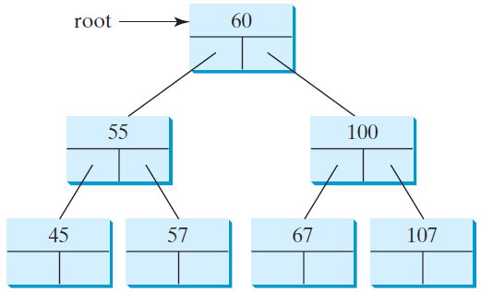
Representing Binary Trees
A binary tree can be represented using a set of linked nodes. Each node contains a value and two links named left and right that reference the left child and right child, respectively
class TreeNode<E> {
E element;
TreeNode<E> left;
TreeNode<E> right;
public TreeNode(E o) {
element = o;
}
}

Slide 42
Binary Search Tree(BST)
A binary search tree (BST) is a binary tree that is either empty or in which every node contains a key (value) and satisfies the following conditions:
All keys in the left sub-tree of the root are smaller than the key in the root
node
All keys in the right sub-tree of the root are greater than the key in the root node
The left and right sub-trees of the root are again binary search trees

Slide 43
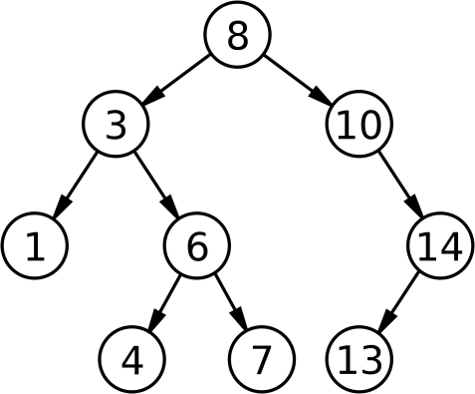
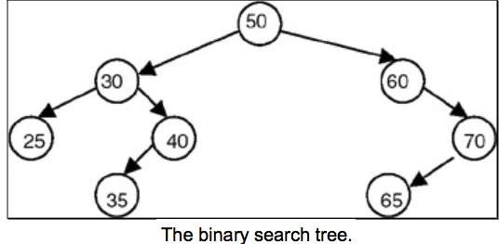
Binary Search Tree(BST)

Slide 44
BST Ordering Applies Recursively
9
3
10
1
5
30
< 9
> 9
9
3
10
1
5
30
< 9
> 9
9
3
10
1
5
30
< 3 & < 9
> 3 & < 9

Slide 45
Binary Search Tree (BST)
A binary search tree is basically a binary tree, and therefore it can be traversed in inorder, preorder and postorder.
If we traverse a binary search tree in inorder and print the identifiers contained in the nodes of the tree, we get a sorted list of identifiers in ascending order.

Slide 46
Binary tree time complexity
It is obvious that the time complexity for the inorder, preorder, and postorder is O(n), since each node is traversed only once. The time complexity for search, insertion and deletion is the height of the tree. In the worst case, the height of the tree is O(n).

Slide 47
Why Binary Search Tree?
Let us consider a problem of searching a list.
If a list is ordered searching becomes faster if we use contiguous list(array).
But if we need to make changes in the list, such as inserting new entries or deleting old entries, (SLOWER!!!!) because insertion and deletion in a contiguous list requires moving many of the entries every time.

Slide 48
Why Binary Search Tree?
So we may think of using a linked list because it permits insertion and deletion to be carried out by adjusting only few pointers.
But in an n-linked list, there is no way to move through the list other than one node at a time, permitting only sequential access.
Binary trees provide an excellent solution to this problem. By making the entries of an ordered list into the nodes of a binary search tree, we find that we can search for a key in O(logn)

Slide 49
Binary Search Tree(BST)
Time Complexity
 | Array | Linked List | BST
Search | O(n) | O(n) | O(logn)
Insert | O(1) | O(1) | O(logn)
Remove | O(n) | O(n) | O(logn)

Slide 50
Operations on Binary Search Tree (BST)
Following operations can be done in BST:
Search(k, T): Search for key k in the tree T. If k is found in some node of tree then return true otherwise return false.
Insert(k, T): Insert a new node with value k in the info field in the tree T such
that the property of BST is maintained.
Delete(k, T):Delete a node with value k in the info field from the tree T such that the property of BST is maintained.
FindMin(T), FindMax(T): Find minimum and maximum element from the given nonempty BST.

Slide 51
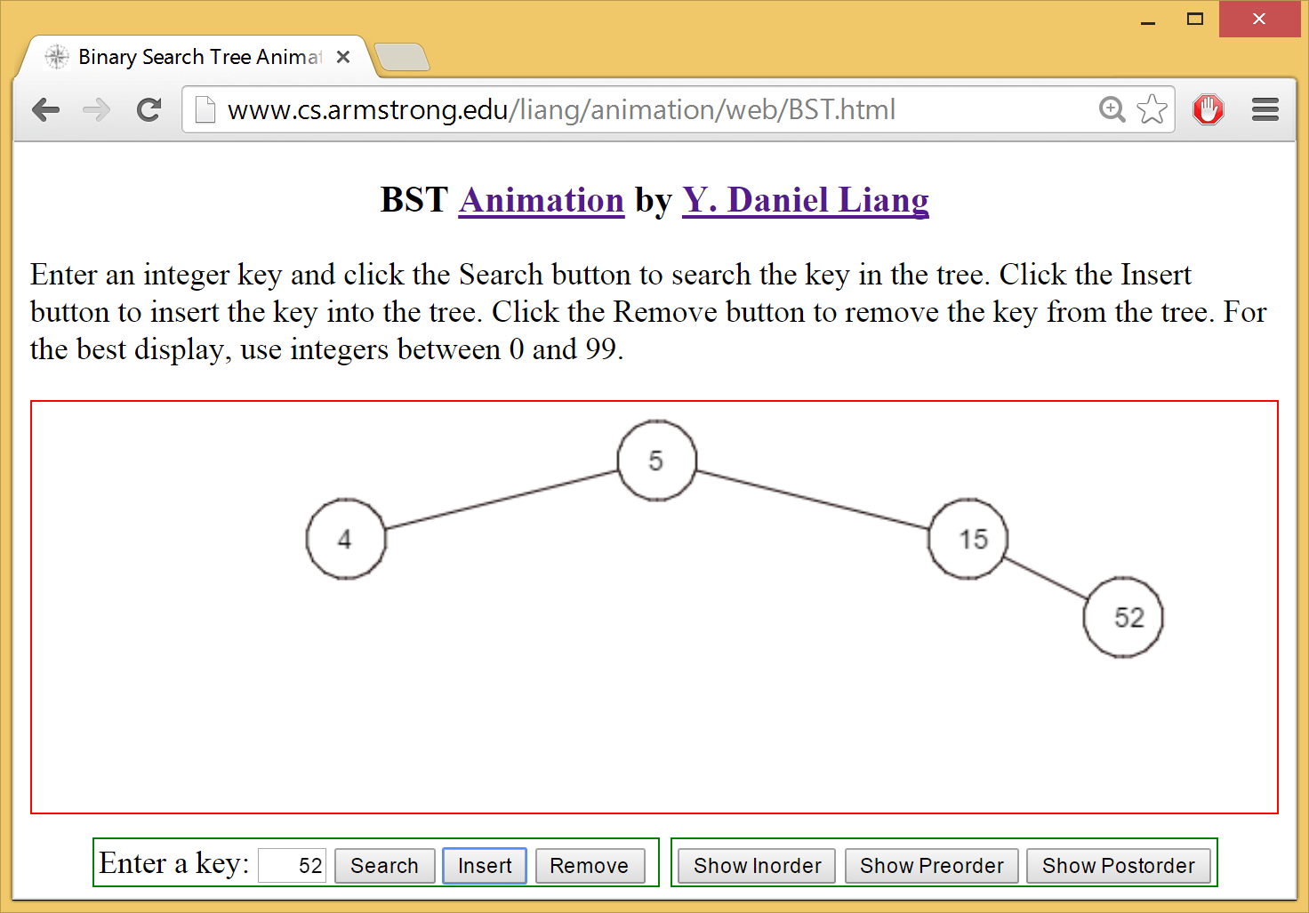
See How a Binary Search Tree Works
https://liveexample.pearsoncmg.com/dsanimation/BSTeBook.html

Slide 52
Searching Through The BST
Compare the target value with the element in the root node
If the target value is equal, the search is successful.
If target value is less, search the left subtree.
If target value is greater, search the right subtree.
If the subtree is empty, the search is unsuccessful.

Slide 53
Searching an Element in a Binary Search Tree
public boolean search(E element) {
TreeNode<E> current = root; // Start from the root
while (current != null)
if (element < current.element) {
current = current.left; // Go left
}
else if (element > current.element) {
current = current.right; // Go right
}
else // Element matches current.element
return true; // Element is found
return false; // Element is not in the tree
}

Slide 54
Insertion of a node in BST
To insert a new item in a tree, we must first verify that its key is different from those of existing elements.
If a new value is less, than the current node's value, go to the left subtree, else go to the right subtree.
Following this simple rule, the algorithm reaches a node, which has no left or right subtree.
By the moment a place for insertion is found, we can say for sure, that a new value has no duplicate in the tree.

Slide 55
Algorithm for insertion in BST
Check, whether value in current node and a new value are equal. If so, duplicate is found. Otherwise,
if a new value is less, than the node's value:
if a current node has no left child, place for insertion has been found;
otherwise, handle the left child with the same algorithm.
if a new value is greater, than the node's value:
if a current node has no right child, place for insertion has been found;
otherwise, handle the right child with the same algorithm.

Slide 56
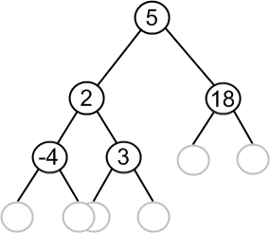
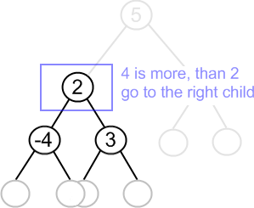
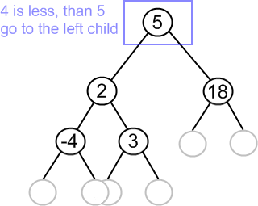
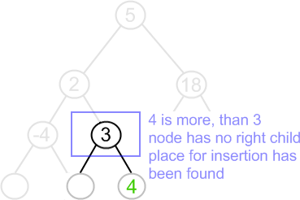
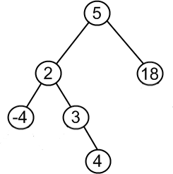

Slide 57
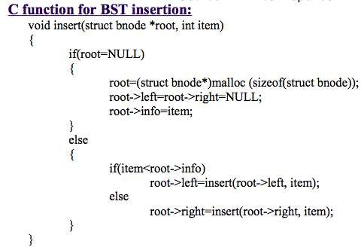

Slide 58
Inserting an Element to a Binary Tree
if (root == null)
root = new TreeNode(element);
else {
// Locate the parent node
current = root;
while (current != null)
if (element value < the value in current.element) {
parent = current;
current = current.left;
}
else if (element value > the value in current.element) {
parent = current;
current = current.right;
}
else
return false; // Duplicate node not inserted
// Create the new node and attach it to the parent node
if (element < parent.element)
parent.left = new TreeNode(elemenet);
else
parent.right = new TreeNode(elemenet);
return true; // Element inserted
}
Insert 101 into the following tree.

Slide 59
Trace Inserting 101 into the following tree
if (root == null)
root = new TreeNode(element);
else {
// Locate the parent node
current = root;
while (current != null)
if (element value < the value in current.element) {
parent = current;
current = current.left;
}
else if (element value > the value in current.element) {
parent = current;
current = current.right;
}
else
return false; // Duplicate node not inserted
// Create the new node and attach it to the parent node
if (element < parent.element)
parent.left = new TreeNode(elemenet);
else
parent.right = new TreeNode(elemenet);
return true; // Element inserted
}
Insert 101 into the following tree.

Slide 60
Trace Inserting 101 into the following tree, cont.
if (root == null)
root = new TreeNode(element);
else {
// Locate the parent node
current = root;
while (current != null)
if (element value < the value in current.element) {
parent = current;
current = current.left;
}
else if (element value > the value in current.element) {
parent = current;
current = current.right;
}
else
return false; // Duplicate node not inserted
// Create the new node and attach it to the parent node
if (element < parent.element)
parent.left = new TreeNode(elemenet);
else
parent.right = new TreeNode(elemenet);
return true; // Element inserted
}
Insert 101 into the following tree.

Slide 61
Trace Inserting 101 into the following tree, cont.
if (root == null)
root = new TreeNode(element);
else {
// Locate the parent node
current = root;
while (current != null)
if (element value < the value in current.element) {
parent = current;
current = current.left;
}
else if (element value > the value in current.element) {
parent = current;
current = current.right;
}
else
return false; // Duplicate node not inserted
// Create the new node and attach it to the parent node
if (element < parent.element)
parent.left = new TreeNode(elemenet);
else
parent.right = new TreeNode(elemenet);
return true; // Element inserted
}
Insert 101 into the following tree.

Slide 62
Trace Inserting 101 into the following tree, cont.
if (root == null)
root = new TreeNode(element);
else {
// Locate the parent node
current = root;
while (current != null)
if (element value < the value in current.element) {
parent = current;
current = current.left;
}
else if (element value > the value in current.element) {
parent = current;
current = current.right;
}
else
return false; // Duplicate node not inserted
// Create the new node and attach it to the parent node
if (element < parent.element)
parent.left = new TreeNode(elemenet);
else
parent.right = new TreeNode(elemenet);
return true; // Element inserted
}
Insert 101 into the following tree.
101 < 60?

Slide 63
Trace Inserting 101 into the following tree, cont.
if (root == null)
root = new TreeNode(element);
else {
// Locate the parent node
current = root;
while (current != null)
if (element value < the value in current.element) {
parent = current;
current = current.left;
}
else if (element value > the value in current.element) {
parent = current;
current = current.right;
}
else
return false; // Duplicate node not inserted
// Create the new node and attach it to the parent node
if (element < parent.element)
parent.left = new TreeNode(elemenet);
else
parent.right = new TreeNode(elemenet);
return true; // Element inserted
}
Insert 101 into the following tree.
101 > 60?

Slide 64
Trace Inserting 101 into the following tree, cont.
if (root == null)
root = new TreeNode(element);
else {
// Locate the parent node
current = root;
while (current != null)
if (element value < the value in current.element) {
parent = current;
current = current.left;
}
else if (element value > the value in current.element) {
parent = current;
current = current.right;
}
else
return false; // Duplicate node not inserted
// Create the new node and attach it to the parent node
if (element < parent.element)
parent.left = new TreeNode(elemenet);
else
parent.right = new TreeNode(elemenet);
return true; // Element inserted
}
Insert 101 into the following tree.
101 > 60 true

Slide 65
Trace Inserting 101 into the following tree, cont.
if (root == null)
root = new TreeNode(element);
else {
// Locate the parent node
current = root;
while (current != null)
if (element value < the value in current.element) {
parent = current;
current = current.left;
}
else if (element value > the value in current.element) {
parent = current;
current = current.right;
}
else
return false; // Duplicate node not inserted
// Create the new node and attach it to the parent node
if (element < parent.element)
parent.left = new TreeNode(elemenet);
else
parent.right = new TreeNode(elemenet);
return true; // Element inserted
}
Insert 101 into the following tree.
101 > 60 true

Slide 66
Trace Inserting 101 into the following tree, cont.
if (root == null)
root = new TreeNode(element);
else {
// Locate the parent node
current = root;
while (current != null)
if (element value < the value in current.element) {
parent = current;
current = current.left;
}
else if (element value > the value in current.element) {
parent = current;
current = current.right;
}
else
return false; // Duplicate node not inserted
// Create the new node and attach it to the parent node
if (element < parent.element)
parent.left = new TreeNode(elemenet);
else
parent.right = new TreeNode(elemenet);
return true; // Element inserted
}
Insert 101 into the following tree.
101 > 60 true

Slide 67
Trace Inserting 101 into the following tree, cont.
if (root == null)
root = new TreeNode(element);
else {
// Locate the parent node
current = root;
while (current != null)
if (element value < the value in current.element) {
parent = current;
current = current.left;
}
else if (element value > the value in current.element) {
parent = current;
current = current.right;
}
else
return false; // Duplicate node not inserted
// Create the new node and attach it to the parent node
if (element < parent.element)
parent.left = new TreeNode(elemenet);
else
parent.right = new TreeNode(elemenet);
return true; // Element inserted
}
Insert 101 into the following tree.
101 > 100 false

Slide 68
Trace Inserting 101 into the following tree, cont.
if (root == null)
root = new TreeNode(element);
else {
// Locate the parent node
current = root;
while (current != null)
if (element value < the value in current.element) {
parent = current;
current = current.left;
}
else if (element value > the value in current.element) {
parent = current;
current = current.right;
}
else
return false; // Duplicate node not inserted
// Create the new node and attach it to the parent node
if (element < parent.element)
parent.left = new TreeNode(elemenet);
else
parent.right = new TreeNode(elemenet);
return true; // Element inserted
}
Insert 101 into the following tree.
101 > 100 true

Slide 69
Trace Inserting 101 into the following tree, cont.
if (root == null)
root = new TreeNode(element);
else {
// Locate the parent node
current = root;
while (current != null)
if (element value < the value in current.element) {
parent = current;
current = current.left;
}
else if (element value > the value in current.element) {
parent = current;
current = current.right;
}
else
return false; // Duplicate node not inserted
// Create the new node and attach it to the parent node
if (element < parent.element)
parent.left = new TreeNode(elemenet);
else
parent.right = new TreeNode(elemenet);
return true; // Element inserted
}
Insert 101 into the following tree.
101 > 100 true

Slide 70
Trace Inserting 101 into the following tree, cont.
if (root == null)
root = new TreeNode(element);
else {
// Locate the parent node
current = root;
while (current != null)
if (element value < the value in current.element) {
parent = current;
current = current.left;
}
else if (element value > the value in current.element) {
parent = current;
current = current.right;
}
else
return false; // Duplicate node not inserted
// Create the new node and attach it to the parent node
if (element < parent.element)
parent.left = new TreeNode(elemenet);
else
parent.right = new TreeNode(elemenet);
return true; // Element inserted
}
Insert 101 into the following tree.
101 > 100 true

Slide 71
Trace Inserting 101 into the following tree, cont.
if (root == null)
root = new TreeNode(element);
else {
// Locate the parent node
current = root;
while (current != null)
if (element value < the value in current.element) {
parent = current;
current = current.left;
}
else if (element value > the value in current.element) {
parent = current;
current = current.right;
}
else
return false; // Duplicate node not inserted
// Create the new node and attach it to the parent node
if (element < parent.element)
parent.left = new TreeNode(elemenet);
else
parent.right = new TreeNode(elemenet);
return true; // Element inserted
}
Insert 101 into the following tree.
101 > 100 true

Slide 72
Trace Inserting 101 into the following tree, cont.
if (root == null)
root = new TreeNode(element);
else {
// Locate the parent node
current = root;
while (current != null)
if (element value < the value in current.element) {
parent = current;
current = current.left;
}
else if (element value > the value in current.element) {
parent = current;
current = current.right;
}
else
return false; // Duplicate node not inserted
// Create the new node and attach it to the parent node
if (element < parent.element)
parent.left = new TreeNode(elemenet);
else
parent.right = new TreeNode(elemenet);
return true; // Element inserted
}
Insert 101 into the following tree.
101 < 107 true

Slide 73
Trace Inserting 101 into the following tree, cont.
if (root == null)
root = new TreeNode(element);
else {
// Locate the parent node
current = root;
while (current != null)
if (element value < the value in current.element) {
parent = current;
current = current.left;
}
else if (element value > the value in current.element) {
parent = current;
current = current.right;
}
else
return false; // Duplicate node not inserted
// Create the new node and attach it to the parent node
if (element < parent.element)
parent.left = new TreeNode(elemenet);
else
parent.right = new TreeNode(elemenet);
return true; // Element inserted
}
Insert 101 into the following tree.
101 < 107 true

Slide 74
Trace Inserting 101 into the following tree, cont.
if (root == null)
root = new TreeNode(element);
else {
// Locate the parent node
current = root;
while (current != null)
if (element value < the value in current.element) {
parent = current;
current = current.left;
}
else if (element value > the value in current.element) {
parent = current;
current = current.right;
}
else
return false; // Duplicate node not inserted
// Create the new node and attach it to the parent node
if (element < parent.element)
parent.left = new TreeNode(elemenet);
else
parent.right = new TreeNode(elemenet);
return true; // Element inserted
}
Insert 101 into the following tree.
101 < 107 true

Slide 75
Trace Inserting 101 into the following tree, cont.
if (root == null)
root = new TreeNode(element);
else {
// Locate the parent node
current = root;
while (current != null)
if (element value < the value in current.element) {
parent = current;
current = current.left;
}
else if (element value > the value in current.element) {
parent = current;
current = current.right;
}
else
return false; // Duplicate node not inserted
// Create the new node and attach it to the parent node
if (element < parent.element)
parent.left = new TreeNode(elemenet);
else
parent.right = new TreeNode(elemenet);
return true; // Element inserted
}
Insert 101 into the following tree.
current is null now

Slide 76
Trace Inserting 101 into the following tree, cont.
if (root == null)
root = new TreeNode(element);
else {
// Locate the parent node
current = root;
while (current != null)
if (element value < the value in current.element) {
parent = current;
current = current.left;
}
else if (element value > the value in current.element) {
parent = current;
current = current.right;
}
else
return false; // Duplicate node not inserted
// Create the new node and attach it to the parent node
if (element < parent.element)
parent.left = new TreeNode(elemenet);
else
parent.right = new TreeNode(elemenet);
return true; // Element inserted
}
Insert 101 into the following tree.
101 < 107 true

Slide 77
Trace Inserting 101 into the following tree, cont.
if (root == null)
root = new TreeNode(element);
else {
// Locate the parent node
current = root;
while (current != null)
if (element value < the value in current.element) {
parent = current;
current = current.left;
}
else if (element value > the value in current.element) {
parent = current;
current = current.right;
}
else
return false; // Duplicate node not inserted
// Create the new node and attach it to the parent node
if (element < parent.element)
parent.left = new TreeNode(elemenet);
else
parent.right = new TreeNode(elemenet);
return true; // Element inserted
}
Insert 101 into the following tree.
101 < 107 true

Slide 78
Trace Inserting 101 into the following tree, cont.
if (root == null)
root = new TreeNode(element);
else {
// Locate the parent node
current = root;
while (current != null)
if (element value < the value in current.element) {
parent = current;
current = current.left;
}
else if (element value > the value in current.element) {
parent = current;
current = current.right;
}
else
return false; // Duplicate node not inserted
// Create the new node and attach it to the parent node
if (element < parent.element)
parent.left = new TreeNode(elemenet);
else
parent.right = new TreeNode(elemenet);
return true; // Element inserted
}
Insert 101 into the following tree.
101 < 107 true

Slide 79
Inserting 59 into the Tree
if (root == null)
root = new TreeNode(element);
else {
// Locate the parent node
current = root;
while (current != null)
if (element value < the value in current.element) {
parent = current;
current = current.left;
}
else if (element value > the value in current.element) {
parent = current;
current = current.right;
}
else
return false; // Duplicate node not inserted
// Create the new node and attach it to the parent node
if (element < parent.element)
parent.left = new TreeNode(elemenet);
else
parent.right = new TreeNode(elemenet);
return true; // Element inserted
}

Slide 80
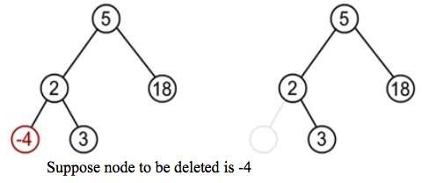
Deleting a node from the BST
While deleting a node from BST, there may be three cases:
The node to be deleted may be a leaf node:
In this case simply delete a node and set null pointer to its parents those side at which this deleted node exist.

Slide 81
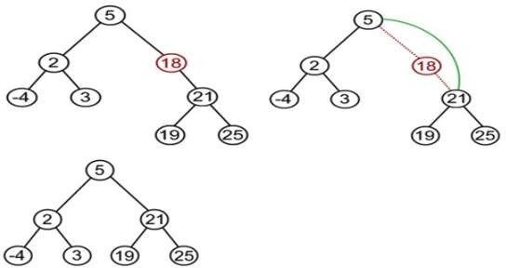
Deleting a node from the BST
The node to be deleted has one child
In this case the child of the node to be deleted is appended to its parent node.
Suppose node to be deleted is 18

Slide 82
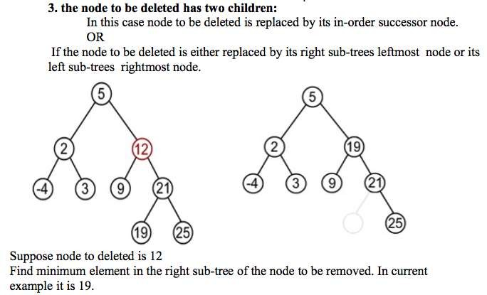
Deleting a node from the BST

Slide 83
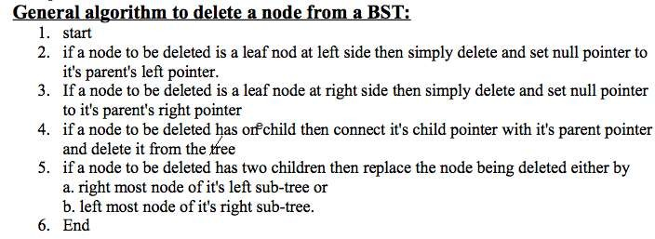

Slide 84
Deleting Elements in a Binary Search Tree
Case 1: The current node does not have a left child, as shown in this figure (a). Simply connect the parent with the right child of the current node, as shown in this figure (b).

Slide 85
Deleting Elements in a Binary Search Tree
For example, to delete node 10 in Figure 25.9a. Connect the parent of node 10 with the right child of node 10, as shown in Figure 25.9b.

Slide 86
Deleting Elements in a Binary Search Tree
Case 2: The current node has a left child. Let rightMost point to the node that contains the largest element in the left subtree of the current node and parentOfRightMost point to the parent node of the rightMost node, as shown in Figure 25.10a. Note that the rightMost node cannot have a right child, but may have a left child. Replace the element value in the current node with the one in the rightMost node, connect the parentOfRightMost node with the left child of the rightMost node, and delete the rightMost node, as shown in Figure 25.10b.

Slide 87
Deleting Elements in a Binary Search Tree
Case 2 diagram

Slide 88
Deleting Elements in a Binary Search Tree
Case 2 example, delete 20

Slide 89
Examples

Slide 90
Examples

Slide 91
Examples

Slide 92
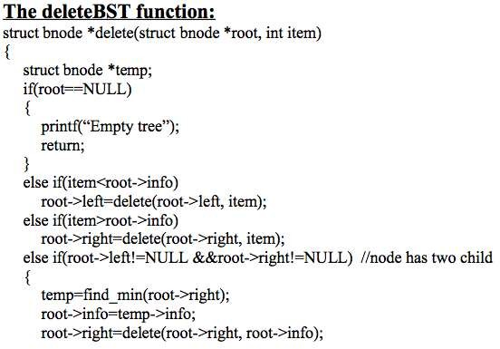
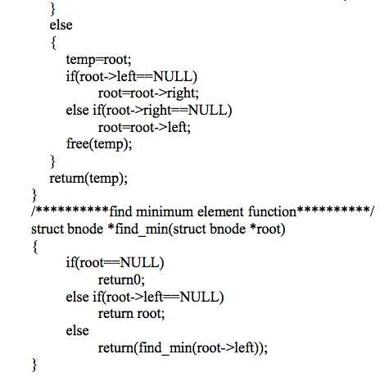

Slide 93
Huffman Algorithm
Huffman algorithm is a method for building an extended binary tree with a minimum weighted path length from a set of given weights.
This is a method for the construction of minimum redundancy codes.
Applicable to many forms of data transmission
multimedia codecs such as JPEG and MP3

Slide 94
Huffman Algorithm
1951, David Huffman found the “most efficient method of representing numbers, letters, and other symbols using binary code”. Now standard method used for data compression.
In Huffman Algorithm, a set of nodes assigned with values if fed to the algorithm. Initially 2 nodes are considered and their sum forms their parent node.
When a new element is considered, it can be added to the tree.
Its value and the previously calculated sum of the tree are used to form the new node which in turn becomes their parent.

Slide 95
Huffman Algorithm
Let us take any four characters and their frequencies, and sort this list by increasing frequency.
Since to represent 4 characters the 2 bit is sufficient thus take initially two bits for each character this is called fixed length character.
character | frequencies
E | 10
T | 7
O | 5
A | 3
Character | frequencies | code
A | 3 | 00
O | 5 | 01
T | 7 | 10
E | 10 | 11
sort
Here before using Huffman algorithm the total number of bits required is: nb = 3*2 + 5*2 + 7*2 + 10*2 = 06 + 10 + 14 + 20 = 50 bits

Slide 96
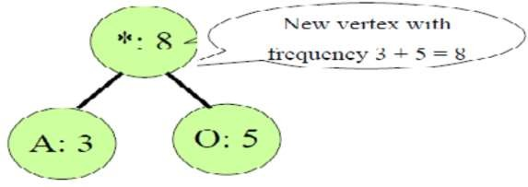
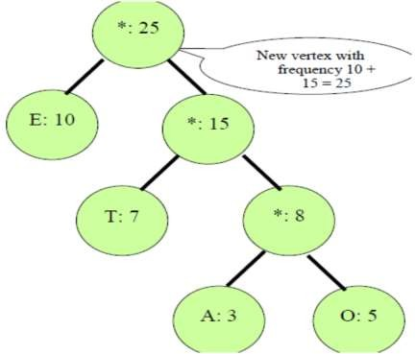
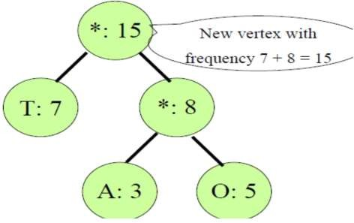

Slide 97
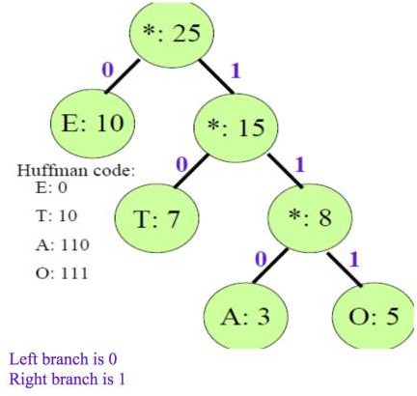
Character | frequencies | code
A | 3 | 110
O | 5 | 111
T | 7 | 10
E | 10 | 0
Thus after using Huffman algorithm the total number of bits required is
nb = 3*3 + 5*3 + 7*2 + 10*1 = 09 + 15 + 14 + 10 = 48bits
i.e
(50 - 48) / 50 * 100% = 4%
Since in this small example we save about 4% space by using Huffman algorithm. If we take large example with a lot of characters and their frequencies we can save a lot of space

Slide 98
Data Compression: Huffman Coding
In ASCII, every character is encoded in 8 bits. Huffman coding compresses data by using fewer bits to encode more frequently occurring characters. The codes for characters are constructed based on the occurrence of characters in the text using a binary tree, called the Huffman coding tree.
Mississippi
000101011010110010011
21 bits

Slide 99
Constructing Huffman Tree
To construct a Huffman coding tree, use a greedy algorithm as follows:
Begin with a forest of trees. Each tree contains a node for a character. The weight of the node is the frequency of the character in the text.
Repeat this step until there is only one tree:
Choose two trees with the smallest weight and create a new node as their parent. The weight of the new tree is the sum of the weight of the subtrees.

Slide 100
Constructing Huffman Tree
Mississippi

Slide 101
Huffman Algorithm
Lets say you have a set of numbers and their frequency of use and want to create a huffman encoding for them
Value | Frequencies
1 | 5
2 | 7
3 | 10
4 | 15
5 | 20
6 | 45

Slide 102
Huffman Algorithm
Creating a Huffman tree is simple. Sort this list by frequency and make the two-lowest elements into leaves, creating a parent node with a frequency that is the sum of the two lower element's frequencies:
12:*
/ \
5:1 7:2
The two elements are removed from the list and the new parent node, with frequency 12, is inserted into the list by frequency. So now the list, sorted by frequency, is:
10:3
12:*
15:4
20:5
45:6

Slide 103
Huffman Algorithm
You then repeat the loop, combining the two lowest elements. This results in:
22:*
/ \
10:3 12:*
/ \
5:1 7:2
The two elements are removed from the list and the new parent node, with frequency 12, is inserted into the list by frequency. So now the list, sorted by frequency, is:
15:4
20:5
22: *
45:6

Slide 104
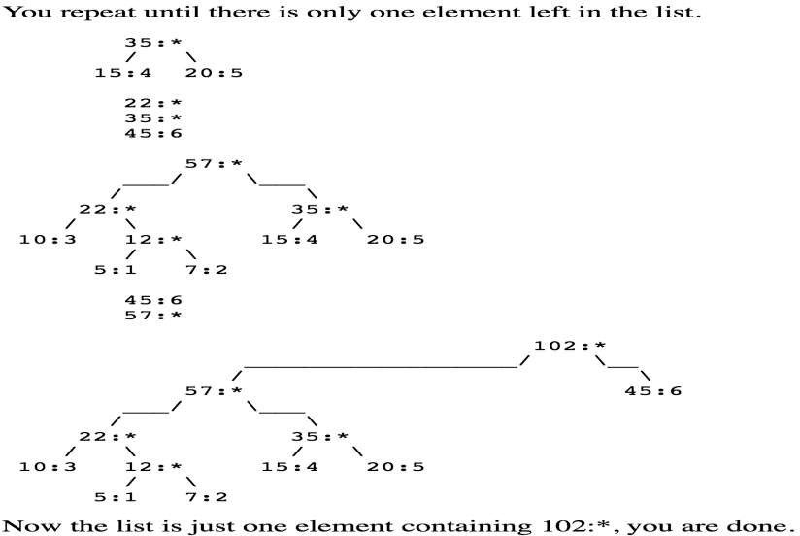
Huffman Algorithm

Slide 105
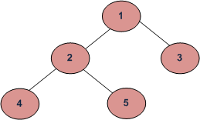
BFS vs DFS for Binary Tree
A Tree is typically traversed in two ways:
Breadth First Traversal (Or Level Order Traversal)
Depth First Traversals:
Inorder Traversal (Left-Root-Right)
Preorder Traversal (Root-Left-Right)
Postorder Traversal (Left-Right-Root)
Breadth First Traversal : 1 2 3 4 5
Depth First Traversals:
Preorder Traversal : 1 2 4 5 3
Inorder Traversal : 4 2 5 1 3
Postorder Traversal : 4 5 2 3 1
All four traversals require O(n) time as they visit every node exactly once.

Slide 106
Size of a tree - Recursion
Size of a tree is the number of elements present in the tree. Size of the below tree is 5.
Size() function recursively calculates the size of a tree. It works as follows:
Size of a tree = Size of left subtree + 1 + Size of right subtree.
Algorithm:
size(tree)
1. If tree is empty then return 0
2. Else
(a) Get the size of left subtree recursively i.e., call
size( tree->left-subtree)
(a) Get the size of right subtree recursively i.e., call
size( tree->right-subtree)
(c) Calculate size of the tree as following:
tree_size = size(left-subtree) + size(right-subtree) + 1
(d) Return tree_size
Time Complexity: Since this program is similar to traversal of tree, time complexity will be same as Tree traversal.

Slide 107
Find maximum (or minimum) in Binary Tree
Given a Binary Tree, find the maximum(or minimum) element in it.
For example, maximum in the following Binary Tree is 9.
In Binary Search Tree, we can find maximum by traversing right pointers until we reach the rightmost node.
Binary Tree, we must visit every node to figure out maximum. So the idea is to traverse the given tree and for every node return maximum of 3 values. 1) Node’s data. 2) Maximum in node’s left subtree. 3) Maximum in node’s right subtree.

Slide 108
Find maximum (or minimum) in Binary Tree
Binary Tree, we must visit every node to figure out maximum. So the idea is to traverse the given tree and for every node return maximum of 3 values. 1) Node’s data. 2) Maximum in node’s left subtree. 3) Maximum in node’s right subtree.
// Returns the max value in a binary tree
static int findMax(Node node)
{
if (node == null)
return Integer.MIN_VALUE;
int res = node.data;
int lres = findMax(node.left);
int rres = findMax(node.right);
if (lres > res)
res = lres;
if (rres > res)
res = rres;
return res;
}

Slide 109
Reference
https://www.siggraph.org/education/materials/HyperGraph/video/mp eg/mpegfaq/huffman_tutorial.html
https://en.wikipedia.org/wiki/Binary_search_tree
https://www.cs.swarthmore.edu/~newhall/unixhelp/Java_bst.pdf
https://www.cs.usfca.edu/~galles/visualization/BST.html
https://www.cs.rochester.edu/~gildea/csc282/slides/C12-bst.pdf
http://www.tutorialspoint.com/data_structures_algorithms/tree_data
_structure.htm

